Slide 1

Real Estate Data Analysis BayArea Data collection-Webscraping

Slide 2

Group-9
Venkata Sai Bala Krishna Batchu
Sai Rohit Reddy Nagella
Supraja Bakki
Rajashekhar Reddy
Chandratej kurella

Slide 3
Introduction:
In this project we are collecting data from a major real estate website and we are using some analytical techniques to find our required data from website. We are using Zillow to scrape our data using python and Beautiful soup libraries. Zillow is one of the major trusted source for searching homes in the United states. So, we are going to scrape bay-area real-estate data from Zillow.
Link to the website : https://www.zillow.com/
Focus -Prime Bay-area locations
Type of data - Float, Int, String

Slide 4
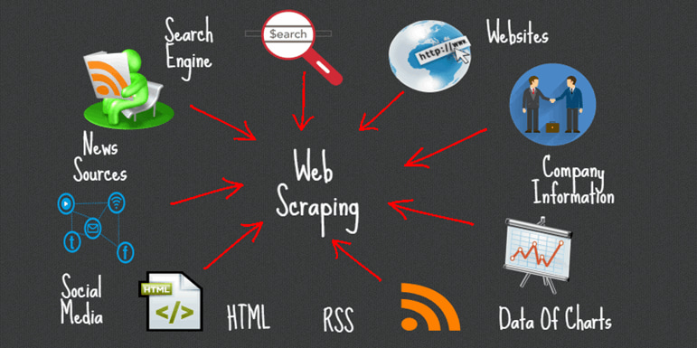
Objectives of Web scraping
Collecting data using Zillow website with beautiful soup and html tags.
Extracting data from only required columns and discarding.
Data conversion to excel or required format.
Overcoming the issues of the web-scraping data blockage.

Slide 5
Steps involved in Web scraping Process
List of County URLs : initial list of counties, each with a link to their initial homepage
Extracted data from webpages of each county : In order to add every webpage to the list, use Beautiful Soup to count them all.
Properties data : Key - County , Value - List of properties. Tags were retrieved from website response, and duplicate links were eliminated while using regex to filter for only properties.
Property information : BS object was created for the property link, and data was collected using various tags.
Converted data to Data frame , Used pandas DataFrame. Extracted data of useful columns. Exported to excel and make data ready for next step pf pipeline data cleaning and analysis.

Slide 6
Challenges Faced
Zillow website is blocking our request to extract data from the urls.
Website responded slowly and failed to load at times when receiving too many access requests.

Slide 7
DataSet Description
Column Name | Data Type
stateId | int
cityId | int
streetAddress | String
city | String
county | String
state | String
zipcode | int
Price | int
bedrooms | int
bathrooms | int
resoFacts_buyerAgencyCompensation(commission) | int
propertyTaxRate | float
resoFacts_pricePerSquareFoot | int
resoFacts_securityFeatures | String

Slide 8
Assumptions
Dealing only with real estate that has been developed with homes.
Focus on San Francisco Bay Area.
Focusing on particular list of counties .
properties with houses built.
Overcoming the blockage by giving sleep time between each request.

Slide 9
Next part to be the data cleaning and analysis of data and analysing price behaviour
Which can be continued in second part of project pipeline which is data analysis.

